Slide 1
Applications of
Artificial Intelligence in
Cognitive Neuroscience
SAiDL, BITS Goa

Slide 2
Overview
Both Deep Learning and Cognitive Neuroscience are fast growing fields of research which are interminably linked together. In fact the main ideas of Deep Learning are inspired from the architecture of the brain itself.
Nowadays we use Deep Neural Networks based on the structure of the neurons in our own brains for various purposes. In this project we will be using them to detect patterns in the EEG data of the brain.
This project will include exploring EEG datasets and various applications of deep learning including data classification, mental state detection, and finally the attainment of “immortality”.

Slide 3
What is Cognitive Neuroscience?
It is the study of biological processes of the brain related to cognition i.e. thought, experience, and the senses.
For example, how does a person’s mood change according to its surrounding? How does the brain perceive and react to different images?

Slide 4
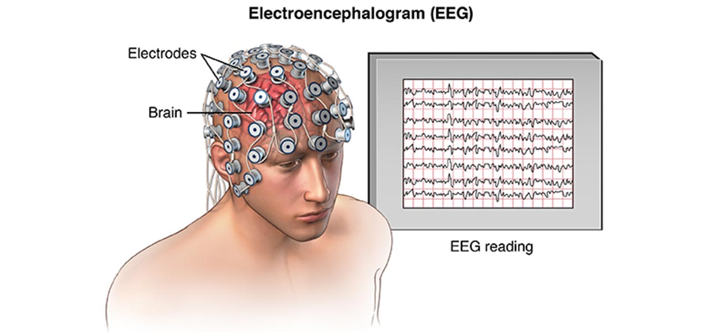
Electroencephalography (EEG)
The neurons in the Brain exchange information through short electrical impulses
Groups of neurons together generate electrical signals due to these impulses
EEG is a measure of these electrical signals

Slide 5
Datasets
Some of the datasets we will be dealing with are -
https://dataverse.harvard.edu/dataset.xhtml?persistentId=doi:10.7910/DVN/ZZR7WX - A dataset on the analyzing the effect of memory in inducing pleasant emotions of musical and pictorial stimuli
https://www.kaggle.com/inancigdem/eeg-data-for-mental-attention-state-detection - An EEG dataset for mental state detection

Slide 6
Concepts
Machine Learning
Deep Learning
Signal processing
Cognitive Neuroscience

Slide 7
Outcomes
Getting familiar with the basics of Machine Learning and Deep Learning
Getting familiar with EEG signals and datasets and basic concepts in cognitive neuroscience
Having completed multiple projects involving AI and neuroscience
Building the student’s profile and contacts
Possibility of publishing a research paper by the end of the project

Slide 8
Project structure
Students will be divided into 3 teams each having 3-4 mentors
Team 1 : Alish Dipani, Sharad Chitlangia, Rijul Ganguly, Souradeep Chakraborty, Aditya Ahuja
Team 2 : Alish Dipani, Het shah, Ashwin Vaswani, Rajaswa Patil
Team 3 : Alish Dipani, Pranav Mahajan, Shangeth, Ajay Subramanian

Slide 9
Timeline
Learning/Revision of required concepts and softwares (Python with necessary libraries)
Working on new datasets each month

Slide 10
Prerequisites
Familiarity with any programming language (Python preferred)
Knowledge of Deep Learning is preferred but not required
Motivation to dedicate time as the project will involve reading papers which can be difficult, analysis of data and experimenting with models.

Slide 11
Any Questions?
Contact Information:
Alish Dipani : 8055565051(Whatsapp only), f20160005@goa.bits-pilani.ac.in
Rijul Ganguly : 9804202305, f20170971@goa.bits-pilani.ac.in
Sharad Chitlangia : 9892219249, f20170472@goa.bits-pilani.ac.in

